Slide 1

See Though Walls with COTS RFID Systems!
Speaker: Lei Yang
Lei Yang, Qiongzheng Lin,
Xiangyang Li, Tianci Liu, Yunhao Liu
Notes:
Good afternoon. My name is Lei Yang, a postdoc fellow from Tsinghua university. Qiongzheng Lin and Tianci Liu are the 3rd year Phd Studen. Prof Xiangyang Li and Yunhao Liu are my supervisors.
It is my honor to present our recent work, see through walls with COTS RFID systems.

Slide 2
Outline
OUTLINE
01.
Motivation
02.
Overview
03.
Understanding Reflections
04.
Extracting Reflections
05.
Tracking Objects
06.
Implementation
07.
Conclusion
Notes:
This is the my talk outline today.

Slide 3
1
Motivation
Notes:
See through wall or passive tracking technology has been widely studied in the community. Many applications would benefit from this technology.

Slide 4
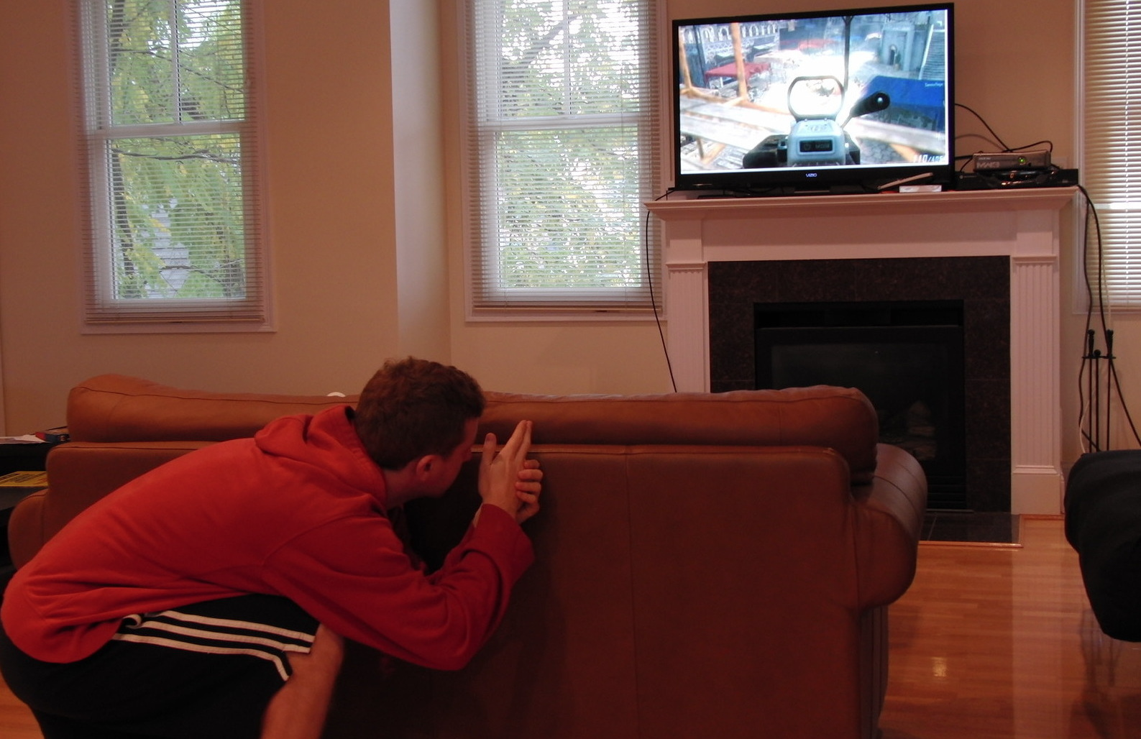
Applications
MOTIVATION
Gaming
Gesture
Control
Notes:
For example, It can be applied for improving the gaming experience and gesture control.

Slide 5
Applications
MOTIVATION
Elderly Surveillance
Intruder Detection
Notes:
It also help elderly surveillance or detect the intruder.

Slide 6
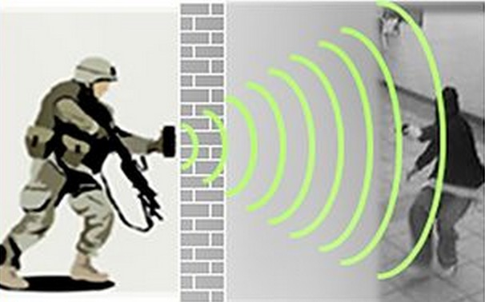
Radar
State-of-art
Occupy a wide band
Impose interference on other devices
Not accessible to civilian in most of the world
Very expensive
Notes:
Mentioned See-through-wall technology, our first response is, “Radar!” Indeed, it has been for a long time studied in the radar community. However, the radar needs a wide frequency band, which may impose interference on other devices. Radar is also not always accessible to civilians in most of the world. More important, it is very expensive.

Slide 7
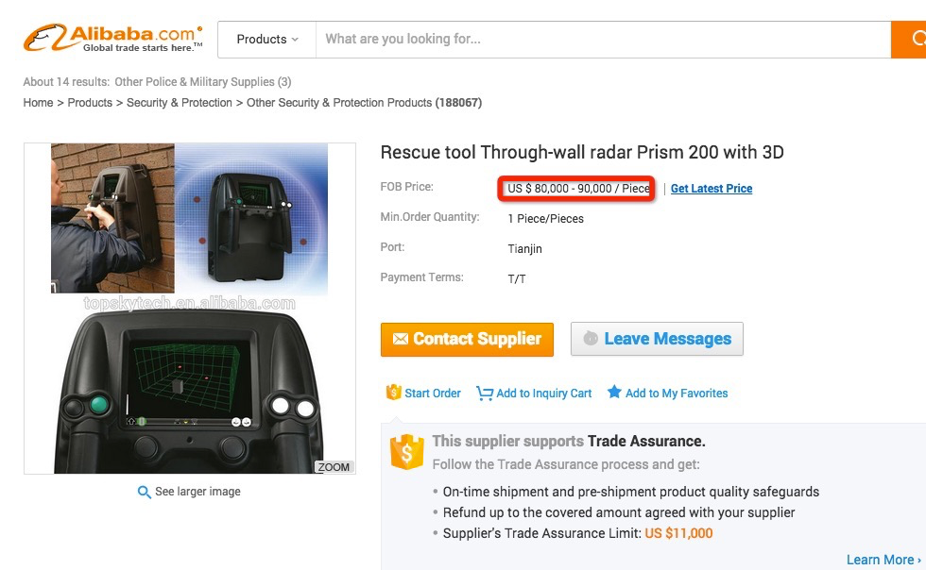

Radar
State-of-art
US$90,000/Set
US$4,500/Set
Occupy a wide band
Impose interference on other devices
Not accessible to civilian in most of countries
Very expensive
Notes:
I search see-through-wall products in alibabba. A normal handled see through wall ranger costs about 4,500 US$. A rescue tool through wall radar costs 90,000 US dollars. They are unaffordable [,ʌnə'fɔ:dəbl] for civilians.

Slide 8
See-through-wall
State-of-art
Wi-Vi
WiTrack
Requiring the customized devices and signals
Notes:
Recently, the research community also explores the feasibilities of seeing through wall with WiFi. Unfortunately, they require the customized devices and signals.
In this work, we are trying to explore the same technology using the commercial products, with legal frequency band, and being accessible to civilians.

Slide 9
2
How does Tadar works?
Overview our idea
Notes:
We turn our attentions to a mature technology, RFID. RFID is evolving as a major technology enabler for identifying and tracking objects all around the world.
In this work, we use the purely commecial RFID to implement a see-through device, called tadar.

Slide 10


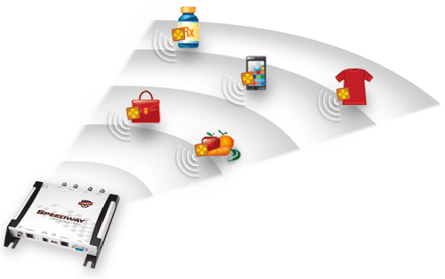
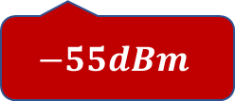
Can RFID systems enable us to track objects through walls?
$$−55dBm$$
Notes:
When I ask the question “Can RFID system enable us to track objects through walls?” Almost everybody answered “absolutely NO!” That's true, in RFID system, the tag modulates its ID through the backscatter signals. This kind of signal are too weak to go through a hand, not to mention a wall.

Slide 11
RFID features
Asymmetric architecture
Reader provides strong signals
Tag is vulnerable to ambient reflections
Reader is good at resolving weak signals
Notes:
Remembering that it is well known that RFID systems adopt an asymmetric architecture in order to reduce the tags’ complexity and costs. Such design has three important features.
First, the reader provides a strong transmitting signal, which is sufficient for two-way traversal through a wall.
Second, the tag has no transceiver and modulates its ID on the backscatter signals. Its modulation is vulnerable to the interference from ambient reflections.
Third, the RFID technology comes from the radar. The system has strong ability to resolve very weak signals from the background.

Slide 12
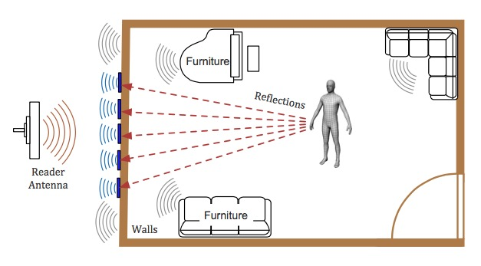
Redefine RFID Systems
BASIC IDEA
Tag
Reader
Reflections
Backscatter signal
Notes:
Inspired by these three features, we redefine RFID system to extend our senses.
we leverage the reader to supply RF signals to light up objects in the room.
we attach an array of tags on the wall and treat them as the antenna array to receive reflections.
Apart from tags, the transmitting signals from reader are also reflected from the moving object.
These reflections plus the original signals from reader provide a combined signal to each tag for their modulations.
As a result, the backscatter signal that carries tag’ ID implicitly contains the reflections from our target.
If we can somehow separate the reflections from the backscatter signal, then we would be able to track the object through walls.

Slide 13

TADAR
Demo
Notes:
Let me show the current status of our research. I am going to show you a video in which a robot taking a notebook as reflector.
You will see the output of our tracking system.
[show video]
This is the tag array and the reader antenna. We deploy them behind the wall.

Slide 14
Summary of Challenges
Quite challenging to separate a weaker signal (reflections) from another weak signal (backscatter signal).
  Based on RSS and Phase values
  No modification and access to low-level layer
Flash effect.
  Reflections off objects are drown in the flash (reflections off walls)
Unpredictable and various diversities.
  Devices diversity over tags and readers.
  Reflectivity varies over different materials of objects.
Notes:
Tadar is compact, low-cost, and accessible to civilians.
The rest of this talk, we will introduce how to address the following challenges.
It is quite challenging to separate a weaker signal from another weak signal. Especially, this task is accomplished purely using the commercial devices. It means we have no any modification and access to the low-level layer.
Second, due to flash effect, the reflections off moving objects are totally drown in the reflections off walls.
We also face various diversities from hardware and objects.

Slide 15
Understanding Reflections
3
How does reflections affect backscatter signals?
Notes:
Firstof all, we conducted a group of empirical studies to better understand how the reflection takes impact on tag’s backscatter signal.

Slide 16
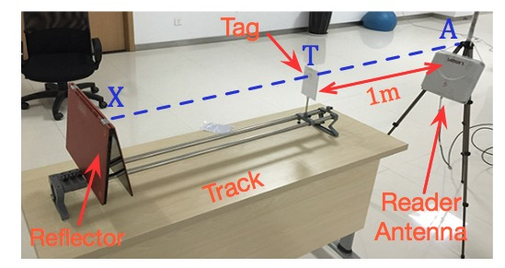
How does reflections affect backscatter signals?
Empirical
Study
Please refer to our paper for details.
Notes:
Due to time limitation, I omit the experiment details and only present the conclusions here. If you have interests, please refer to our paper.

Slide 17






Summary
Empirical
Study
Tag $T$
Reflector $X$
Reader $A$
①$A→T$
Summary #1: There exist three dominated propagation paths.
$$\text{②} A→X→T$$
③ $T→A$
Notes:
The first conclusion is that: there exist three dominated propagation paths among the reader, tag and reflector.
The first path is from reader A to tag T.
The second path is from reader A, reflected of X and then to tag T.
The third path is from tag T to reader A.

Slide 18

Summary
Empirical
Study
Reflection
Original
signal
Tag $T$
Reflector $X$
Reader $A$
Summary #2: Tag modulates its ID using the combined signals from $A→X→T$ and $A→T$.
Notes:
The second conclusion is that, the signals propagate through the first two paths combine at the tag.

Slide 19

Summary
Empirical
Study
Tag $T$
Backscatter signal
Reflector $X$
Reader $A$
Summary #2: Tag modulates its ID using the combined signals from $A→X→T$ and $A→T$.
Notes:
The tag uses the combined signal to modulate its ID and sends back to the reader.

Slide 20
How to extract the reflections from backscatter signals?
The key is
Notes:
Thus, the backscatter signal collected by the reader implicitly contains the reflections from our target. If we can somehow separate the reflections from the backscatter signal, then we would be able to track the object through walls.

Slide 21
4
Extracting Reflections
Separating the implicit reflections from backscatter signals
Case #1
Case #2
Case #3
Notes:
So our first task is to extract reflections. We consider three cases.

Slide 22
Case #1: Signal propagates through the LOS without any reflections.
Notes:
Case I: The signal between reader and tag propagates through the light-of-sight without any reflections.

Slide 23



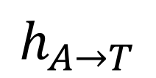
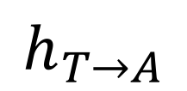
Case #1
Channel parameter
$$h_{A→T}$$
Reader $A$
Tag $T$
$$h_{T→A}$$
$$S_{T→A}={h_{AR}h}_{T→A }h_{TT}S_{A→T}$$
Notes:
This figure illustrates the first case. The reader transmits a signal to tag. The tag backscatters its ID.
In this case, we can model the signal using this equation.
𝑆_(𝐴→𝑇) is the transmitting signal from reader and received by the tag.
$S_{T→A}$ is the backscatter signal that the reader received and backscattered from T

Slide 24
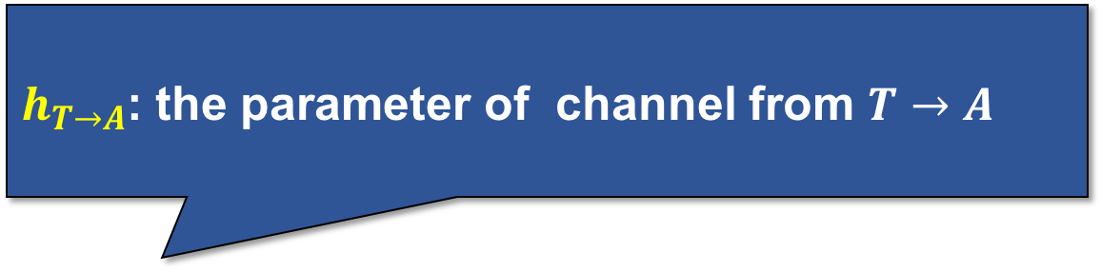

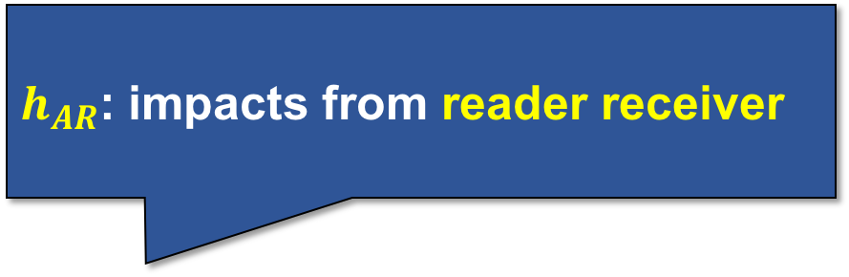
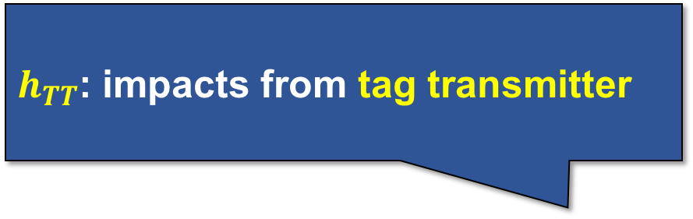
$h_{AR}$: impacts from reader receiver
Case #1
$$h_{A→T}$$
$h_{TT}$: impacts from tag transmitter
Reader $A$
Tag $T$
$$h_{T→A}$$
$h_{T→A}$: the parameter of channel from $T→A$
$$S_{T→A}={h_{AR}h}_{T→A }h_{TT}S_{A→T}$$
$$S_{T→A}={h_{AR}h}_{T→A }h_{TT}S_{A→T}$$
Notes:
There are also many other variables in equation. More details.
1.
2.
3.
It seems a little complicate and the variables seems distracted, but don’t worry. We will deal with them latter.

Slide 25
Case #2: Tags are attached on the outer wall and no object of interest moves in the room.
Notes:
In second case, we attach tags on the wall, but keep the room empty. Namely, no target moves in the room.

Slide 26
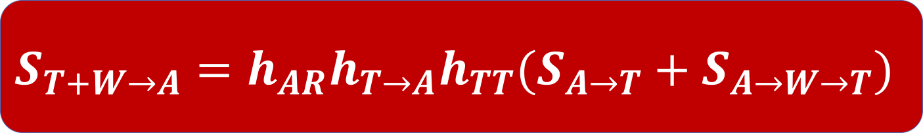


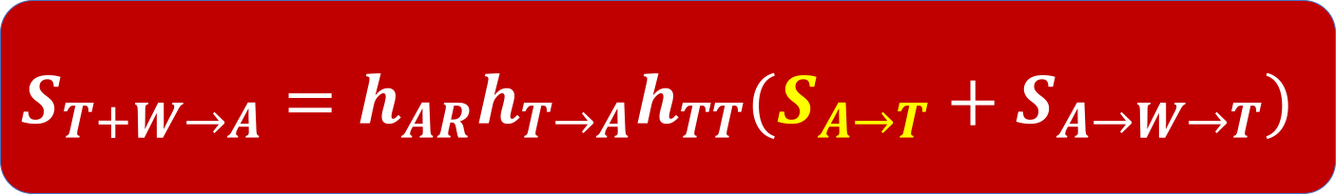
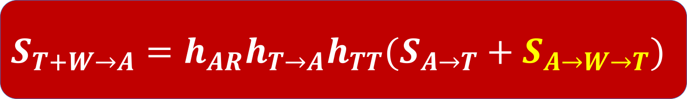

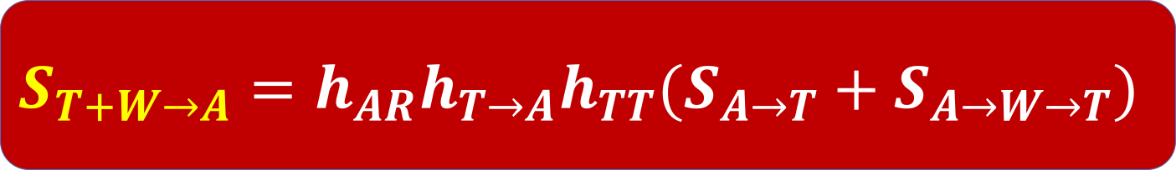
Case #2
Flash
Wall $W$
Reader $A$
Tag $T$
$$S_{T+W→A}={{h_{AR}h}_{T→A}h}_{TT}(S_{A→T}+S_{A→W→T})$$
$$S_{T+W→A}={{h_{AR}h}_{T→A}h}_{TT}(S_{A→T}+S_{A→W→T})$$
$$S_{T+W→A}={{h_{AR}h}_{T→A}h}_{TT}(S_{A→T}+S_{A→W→T})$$
$$S_{T+W→A}={{h_{AR}h}_{T→A}h}_{TT}(S_{A→T}+S_{A→W→T})$$
Notes:
In this case, besides the tag, other static objects, such as walls, furniture, chairs, also reflect the signal emitted from the reader. We call these reflections flash.
In our equation, we treat the reflections from the static objects as if they were reflected from a single virtual point W. In this way, the backscatter signal are model like this, in which the tag receives two signals from A and from W respectively

Slide 27
Case #3: The object of interest moves in the room.
Notes:
Lastly, we consider the third case, in which our target object moves in the room.

Slide 28

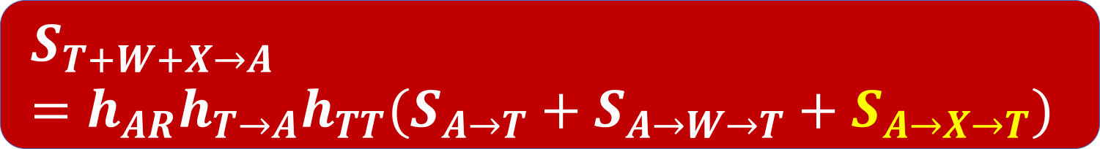
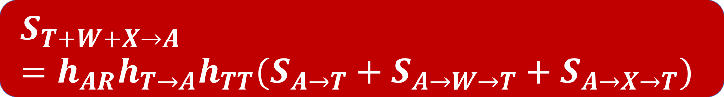

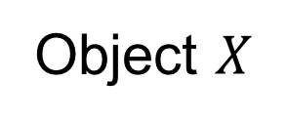


Case #3
Wall $W$
$$S_{A→T}$$
$$S_{A→w→T}$$
Reader $A$
Tag $T$
$$S_{A→X→T}$$
Object $X$
$$S_{T+W+X→A}={{h_{AR}h}_{T→A}h}_{TT}(S_{A→T}+S_{A→W→T}+S_{A→X→T})$$
$$S_{T+W+X→A}={{h_{AR}h}_{T→A}h}_{TT}(S_{A→T}+S_{A→W→T}+S_{A→X→T})$$
Notes:
Due to the existence of object X, an additional signal is reflected to the tag. Then the backscatter signal fomula is revised like this where the $S_{A→X→T}$ is the reflection signal from the object.

Slide 29
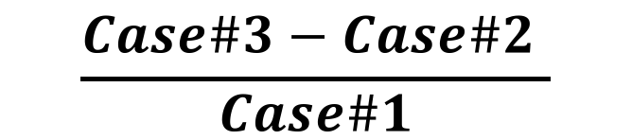
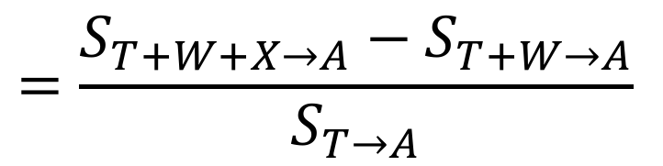
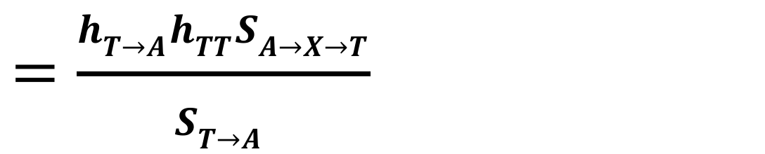
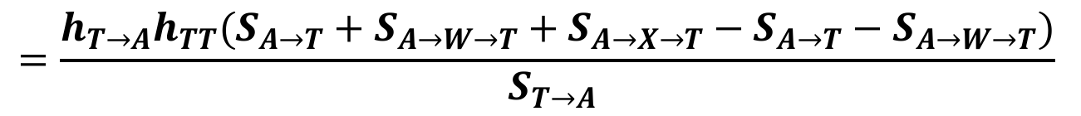
Reflection
Deriving the Reflection
$$\frac{Case\#3−Case\#2 }{Case\#1}$$
$$=\frac{{S_{T+W+X→A}−S}_{T+W→A}}{S_{T→A}}$$
$$=\frac{{h_{T→A}h}_{TT}(S_{A→T}+S_{A→W→T}+S_{A→X→T}−S_{A→T}−S_{A→W→T})}{S_{T→A} }$$
$$=\frac{{h_{T→A}h}_{TT}S_{A→X→T}}{S_{T→A} }$$
Notes:
To derive the reflection, we use the backscatter signals collected in case#3 to subtract the signal collected in case#2, and then divide the signal collected in case#1.
We see that, through the subtraction, the flash reflected off static objects as well as the signal from reader are all removed.
Let’s further zoom in to the reflection signal. What is the $S_{A→X→T}$?

Slide 30


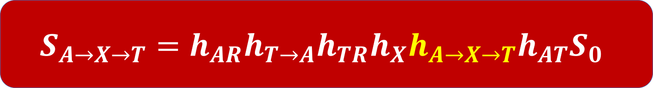
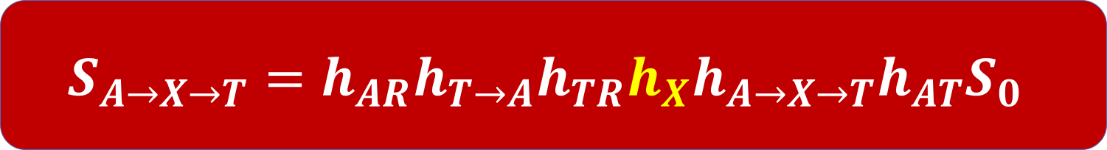

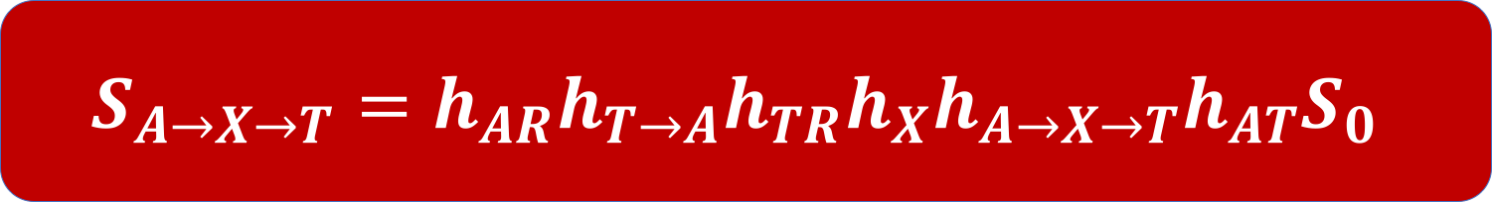
Case #3
Focusing on $S_{A→X→T}$
Wall $W$
Reader $A$
Tag $T$
$$h_{X}$$
$$h_{A→X→T}$$
Object $X$
Reflectivity
Our goal
$$S_{A→X→T}=h_{AR}h_{T→A}h_{TR}h_{X}h_{A→X→T}h_{AT}S_{0}$$
$$S_{A→X→T}=h_{AR}h_{T→A}h_{TR}h_{X}h_{A→X→T}h_{AT}S_{0}$$
$$S_{A→X→T}=h_{AR}h_{T→A}h_{TR}h_{X}h_{A→X→T}h_{AT}S_{0}$$
Notes:
$S_{A→X→T}$ is the signal that transmitted from reader A, reflected by object X, and received by the tag T. It can be modeled like this.
This equation seems a little complex. Don’t worry about it. Most of the variables will be well handled later.
Here, we only care about two special variables:
$h_{A→X→T}$ is the parameter of channel from A, to X, then to T. It is the only variable related to the object's location. Our goal is to resolve it!
$h_{X}$ denotes the impacts of the object's reflectivity. Different objects takes different impacts on the reflection. It depends on the object's materials. It is unkown.

Slide 31
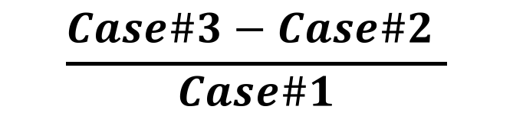
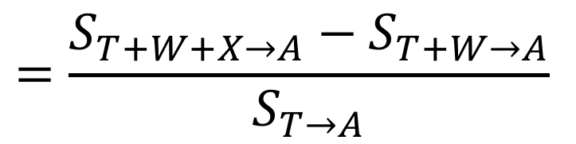
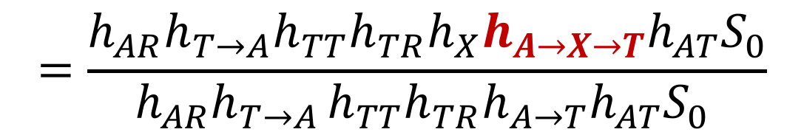
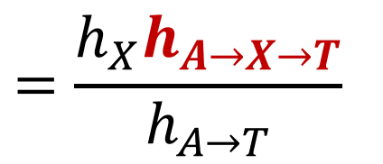
Reflection
Deriving the Reflection
$$\frac{Case\#3−Case\#2 }{Case\#1}$$
$$=\frac{{S_{T+W+X→A}−S}_{T+W→A}}{S_{T→A}}$$
$$=\frac{h_{AR}h_{T→A}h_{TT}h_{TR}h_{X}h_{A→X→T}h_{AT}S_{0}}{{{{h_{AR}h}_{T→A }{h_{TT}h}_{TR}h}_{A→T}h_{AT}S}_{0} }$$
$$=\frac{h_{X}h_{A→X→T}}{h_{A→T}}$$
Notes:
We substitute the reflection formula into derivation.
Something amazing happens, almost all unknown parameters related to the hardwares are eliminated by the division.
The derivation seems complicated, but the result is so compact and graceful.

Slide 32
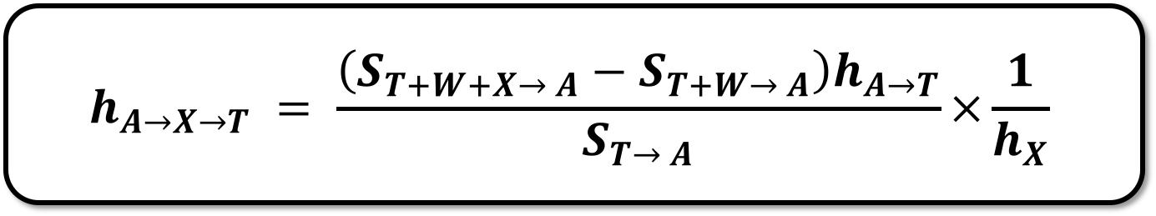
Tadar’s Advantages
Case#3
Case#2
calculable
Reflection channel
$$h_{A→X→T} = \frac{\left(S_{T+W+X→ A}−S_{T+W→ A}\right)h_{A→T}}{S_{T→ A}}×\frac{1}{h_{X}}$$
Case#1
Constant
Tadar is independent on all unknown hardware variables and transmitting signals.
Notes:
After transforming, we have this expression. Let us review these terms’ meanings.
$h_{A→X→T}$ is the parameter of the channel from reader A, reflected by object , and then to the tag T. This item purely depends on the target’ location. If we know this term, the object’s location can be inferred.
$S_{T+W+X→ A}$ is the backscattered signal collected in the third case.
$S_{T+W→ A}$ is the backscattered signal collected in the second case.
$S_{T→ A}$ is the backscatter signal collected in the first case.
$h_{A→T}$ is the parameter of channel A to T. Since the locations of reader and tag are known in advance, it is calculable.
$h_{X}$ is the parameter related to the materials of the object. Although we have no idea about it, it is a constant. It is very easy to remove a constant using mathematical tricky. We will introduce how to doit later. Here, we ignore it temporarily.
Based on this equation, we can see that:
It is amazing that Tadar is independent on hardware variables. It means that we do not need to care which or what devices you are using. Of course, we also do not need a calibration in advance.
It is more amazing that Tadar is independent on transmitting signal. It means that we do not need to care about the reader’s implementation details in physical-layer.

Slide 33



Putting things together
Step 1: Learning the $S_{A→T}$ while keeping LOS propagation and reflection-free.
Step 2: Learning the $S_{A+W→T}$ after attaching tags on the wall and keeping room empty.
Step 3: Deriving the reflection $h_{A→X→T}$ when the object moves in the room.
Notes:
Now, we put all things together.
Our algorithm has three step:
In the first step, ...
In the second step, ...
In the third step, ...

Slide 34
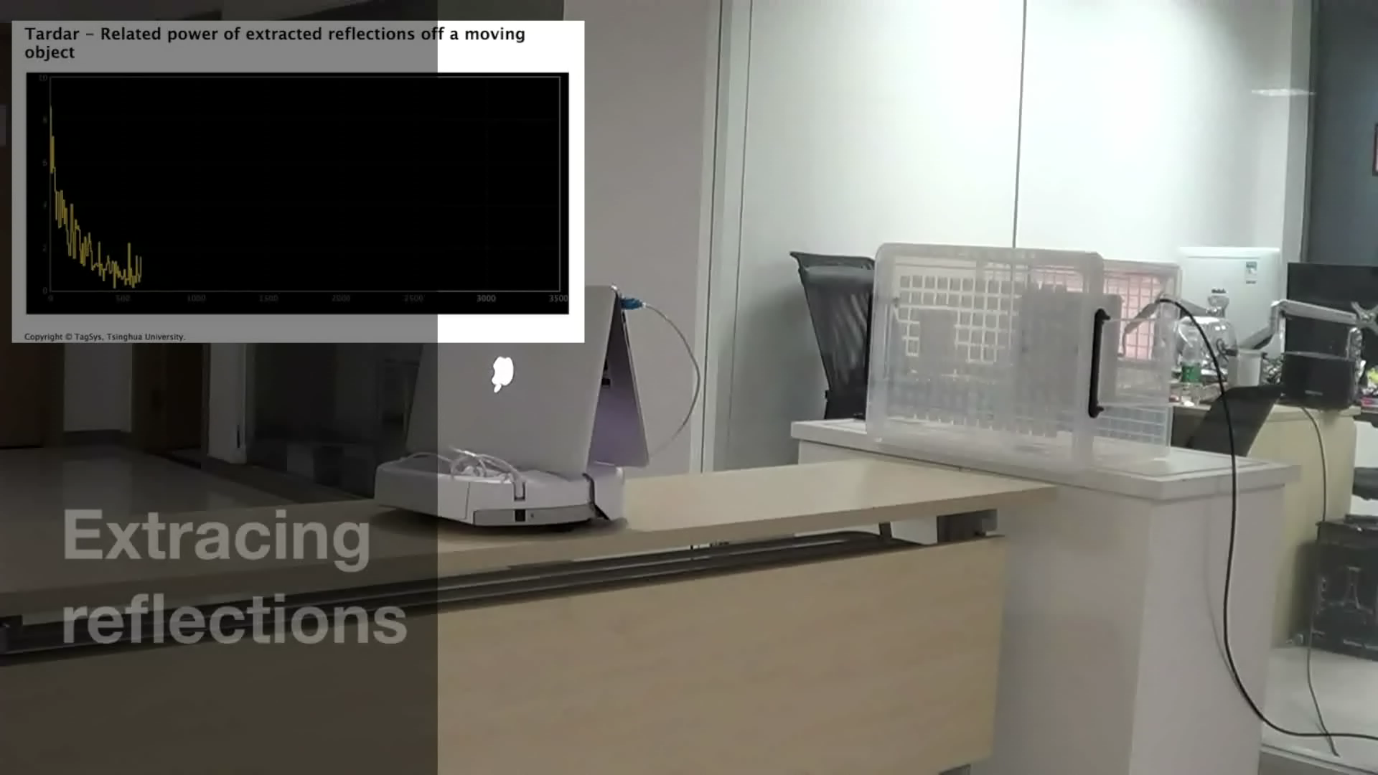
Extracted Reflections
Demo
Notes:
Here, we show a short demo to see the separated reflections. The yellow liens in the top left corner shows the extracted reflections’ power. As the distance increases, the power decreases.

Slide 35
5
Tracking Moving Object
Using the extracted reflections
Notes:
Our next task is to track the moving object using the extracted reflections.

Slide 36






Scattering Model
Scattering
$$T_{1}$$
$$T_{2}$$
$$X$$
$$R$$
$$T_{3}$$
$$T_{4}$$
Notes:
There, we adopt the scattering model.
We assume the transmitting signals are scattered by the object to one or more tags. In other words, the reflections will be received by multiple tags.

Slide 37
HMM based Tracking
Hidden State
Transition
Observations
Using HMM to model the motion
Notes:
Then we use the Hidden Markov to model the object's motion.
We view the target location as the hidden state, and the separated reflections as the observations. We the system performs a transition when the object moves from one location to another.

Slide 38
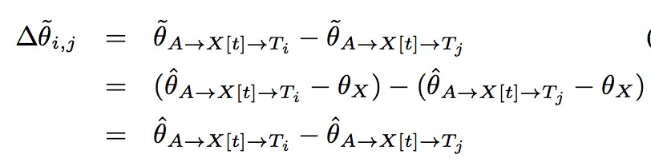

How to eliminate the reflectivity
Choosing one tag as reference to remove the impact from reflectivity $h_{X}$.
Notes:
In order to eliminate the h_x, the impact of the object due to its materials. We choose one tag as reference and use other tag’s backscatter signal to subtract that of reference.

Slide 39
6
Implementation & Evaluation
Purely based on COTS devices
Notes:
We implement tadar on COTS devices.

Slide 40
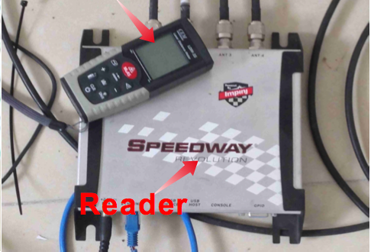



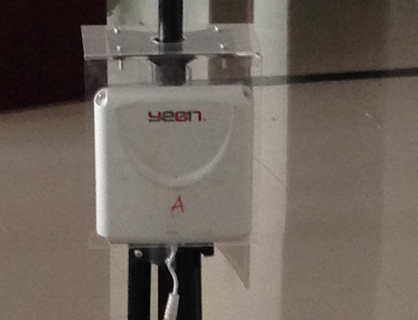

Hardware & Software Introduction
Reader
Tag
Software
ImpinJ R420 reader.
Alien 2 × 2 Inlay
EPCglobal LLRP
Java
directional antenna
Alien Squiggle Inlay
Notes:
We implement the whole system purely using the COTS RFID devices, we use the Impinj reader and Alien tags

Slide 41
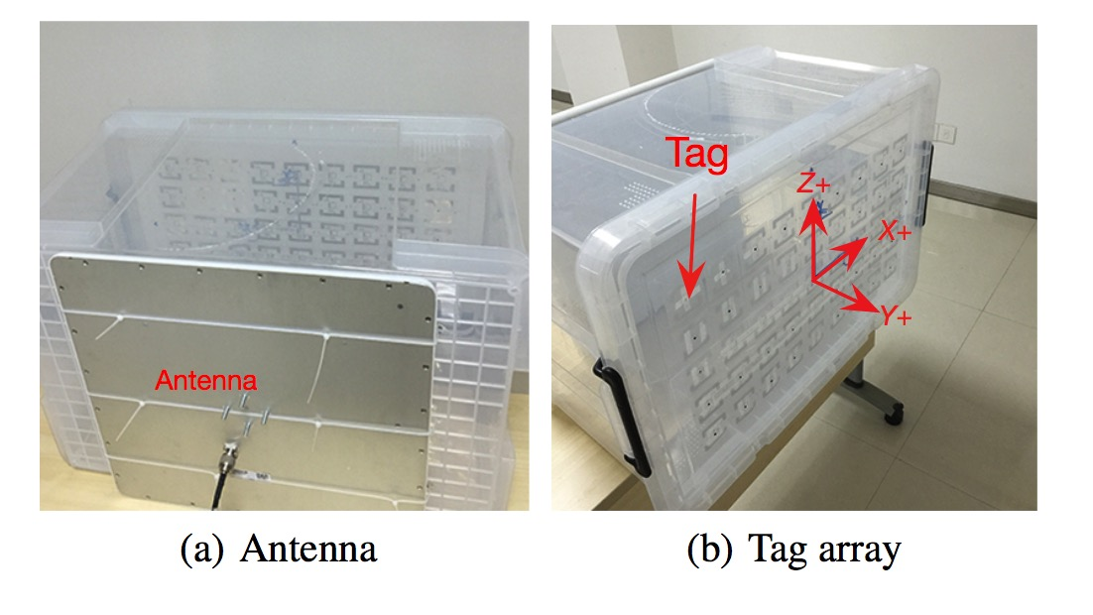
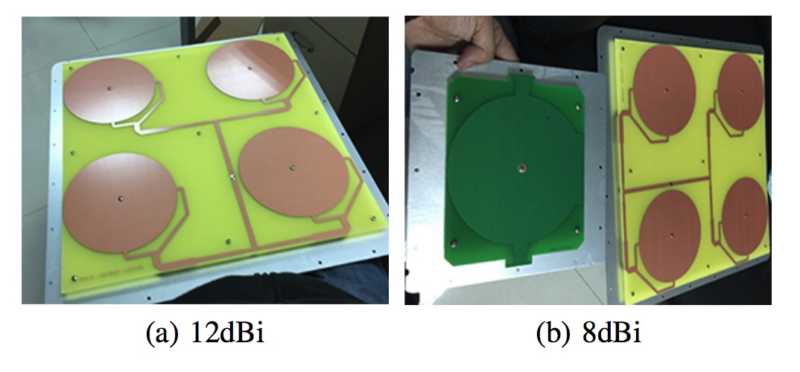
Experiment Setup
A plastic box is used to maintain the geometric relationships.
High-gain directional antenna.
Notes:
We attach the tags on a plastic box in stead of a wall to maintain their geometric relationships, so that we can move it everywhere for measuremnt.
To travel across a concrete wall, we adopt a high-gain directional antenna with 12 dBi gain.

Slide 42
Diversity Elimination
Separated reflection
Reflection-free
With reflection
Tardar well eliminates the impacts from the unknown hardware diversities.
Notes:
One key functionality of tadar is to separate the reflections from the backscatter signals while eliminate the impacts from various hardware factors.
[Animate]
We use grids to show the power of the backscatter signal collected by the reader. In the figure , each grid represents a tag and its gray value denotes the power. More light means much stronger. The first figure shows the signals under the case that there are no reflections. Since no reflections exist, the color should be similar for each other. As you see, the distribution of the power is totally out of order due to the diversity.
[Animate]
We place a smart phone in front of the tag array. We see that many grids become lighter because of the reflections off the smart phone. This also validate our scattering model that the signal will be reflected to everywhere. The power distribution is still out of order.
[Animate]
In the thrid figure, we show the power of separated reflections. As you can see the central grid is brightest because it is cloest to smart phone.

Slide 43
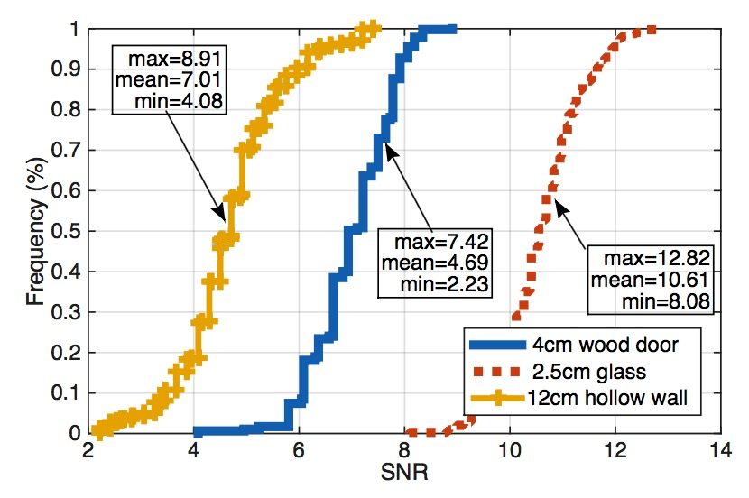
Reflection Acquisition
0.98′′ glass, 1.5′′ wood door and 5′′ hollow
Notes:
Our evaluation shows that the system can

Slide 44
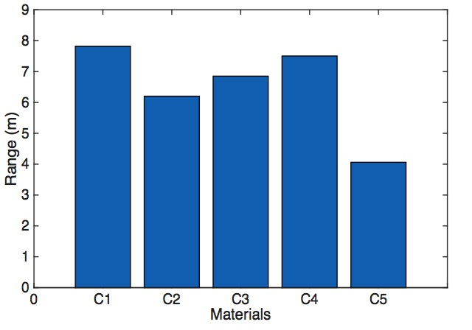
Building Materials
free space (C1), 5′′ hollow wall (C2), 1.5′′ wood door (C3), 0.98′′ glass (C4), and 8′′ concrete (C5).
Notes:
Next, let’s see how tardar performs as a function of the material of the wall.
We can furthest detect the mobile object at 8 meters in free space.
However, the range drops to 3 meters. This expected because concrete is thicker and it is much harder to pass through. Therefore, the signal is weakened a lot after it traverse twice.

Slide 45
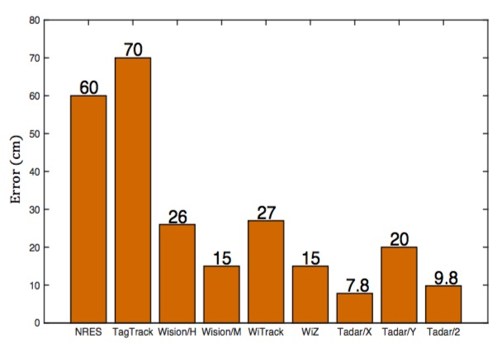



Tracking Accuracy
$$20$$
$$7.8$$
$$9.8$$
Tardar
It outperforms the existing none-UWB tracking approaches by 3×, 3.5× and 1.3× compared with NRES, TagTrack and Wision.
Notes:
We also compare the tracking accuracy with other existing works. We find that tadar can achieve 7.8 centimeters along the x dimension and 20 centimeters along y dimension. It outperforms the existing none ultra wide band tracking approaches by 1.3 times at least.

Slide 46
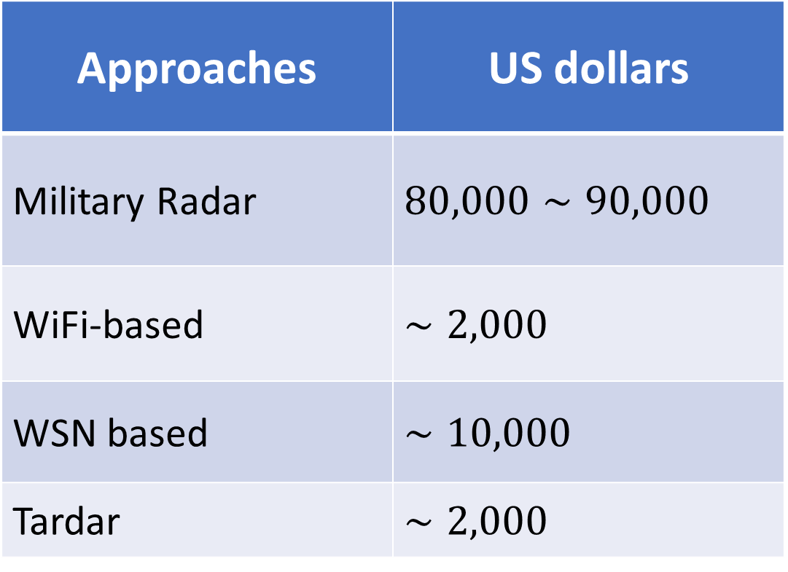
Cost Comparisons
Approaches | US dollars
Military Radar | $$80,000∼90,000$$
WiFi-based | $$∼2,000$$
WSN based | $$∼10,000$$
Tardar | $$∼2,000$$

Slide 47
Limitations & Future work
Direction dependent
Learning environment ahead of time
Tracking single object
Notes:
Tadar marks an contribution by enabling device-free mobile object tracking. However, it still has some limitations that left for our future work.
Since the bot rfid tags and reader antenna are directional, the whole system is also direction-dependent. Current prototype distributes tags in a fairly large area to enable them to capture different perspectives of the mobilec objects in the scene.
A second limination stems from the fact that tadar needs to train the channel paramters of empty room in advance to eliminate the flash effet.
Our algorithm design present in this paper can track only single object at any point in time.

Slide 48
Conclusion
Low-cost solution to the through-wall tracking of moving objects, enabling civilians purpose.
Converting a group of tags attached on the wall into a receiving antenna array.
It demonstrates a working system implemented purely based on COTS devices.

Slide 49
Questions?
T
hank you

Slide 50
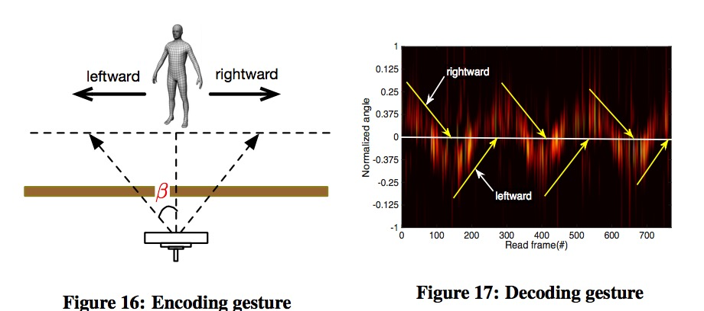
Application Study

Slide 51
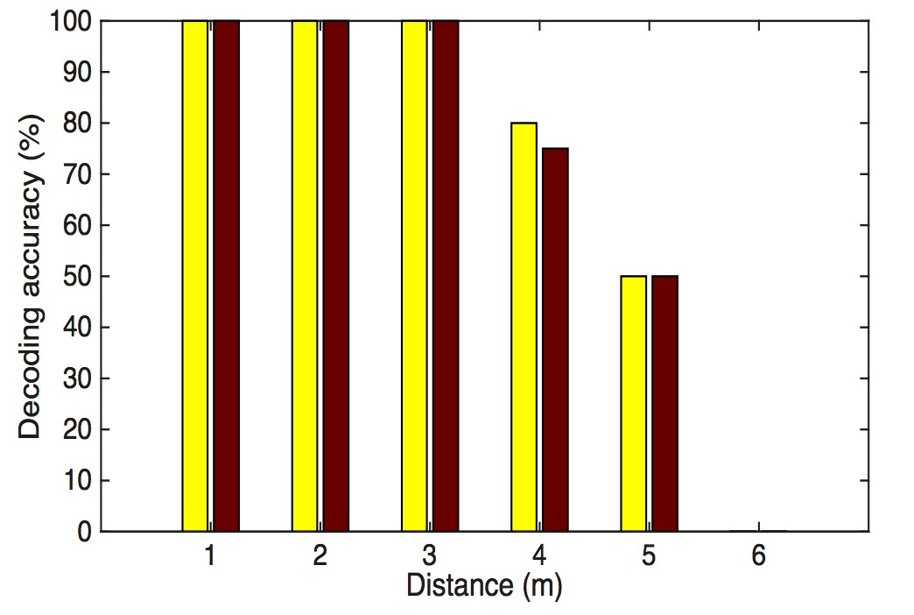
Application Study

